Slide 1
Exoplanet Detections:
Which Methods Work?
Tayt Armitage, Bailey Stephens, Lauren Robinson, Caitlin O’Brien, Ethan Fahimi

Slide 2
Motivation
Exoplanets give us hints about the Universe’s structure
Several exoplanet detection methods exist
Methods have varying effectiveness under different conditions

Slide 3
General Procedure For Finding State-of-the-Art
Determine “signal” equation used for detections
Find state-of-the-art (SOA) signal standard
Plot scaling relationship on top of modern-day data

Slide 4
Simulated System
Jupiter-like planet around a Sun-like star
As close as the closest imaged solar system (11 pc away)
Characteristics (i.e., semimajor axis) are same as our Jupiter
Simulations done by Caitlin

Slide 5
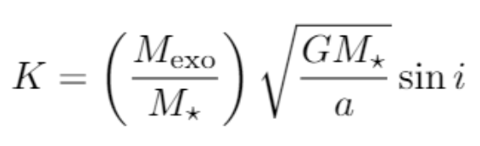
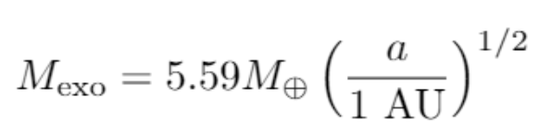
Radial Velocity Equation
SOA: K = 0.5 m/s
i = 90 degrees
Orbiting Sun-like star
Equations calculated by Lauren

Slide 6
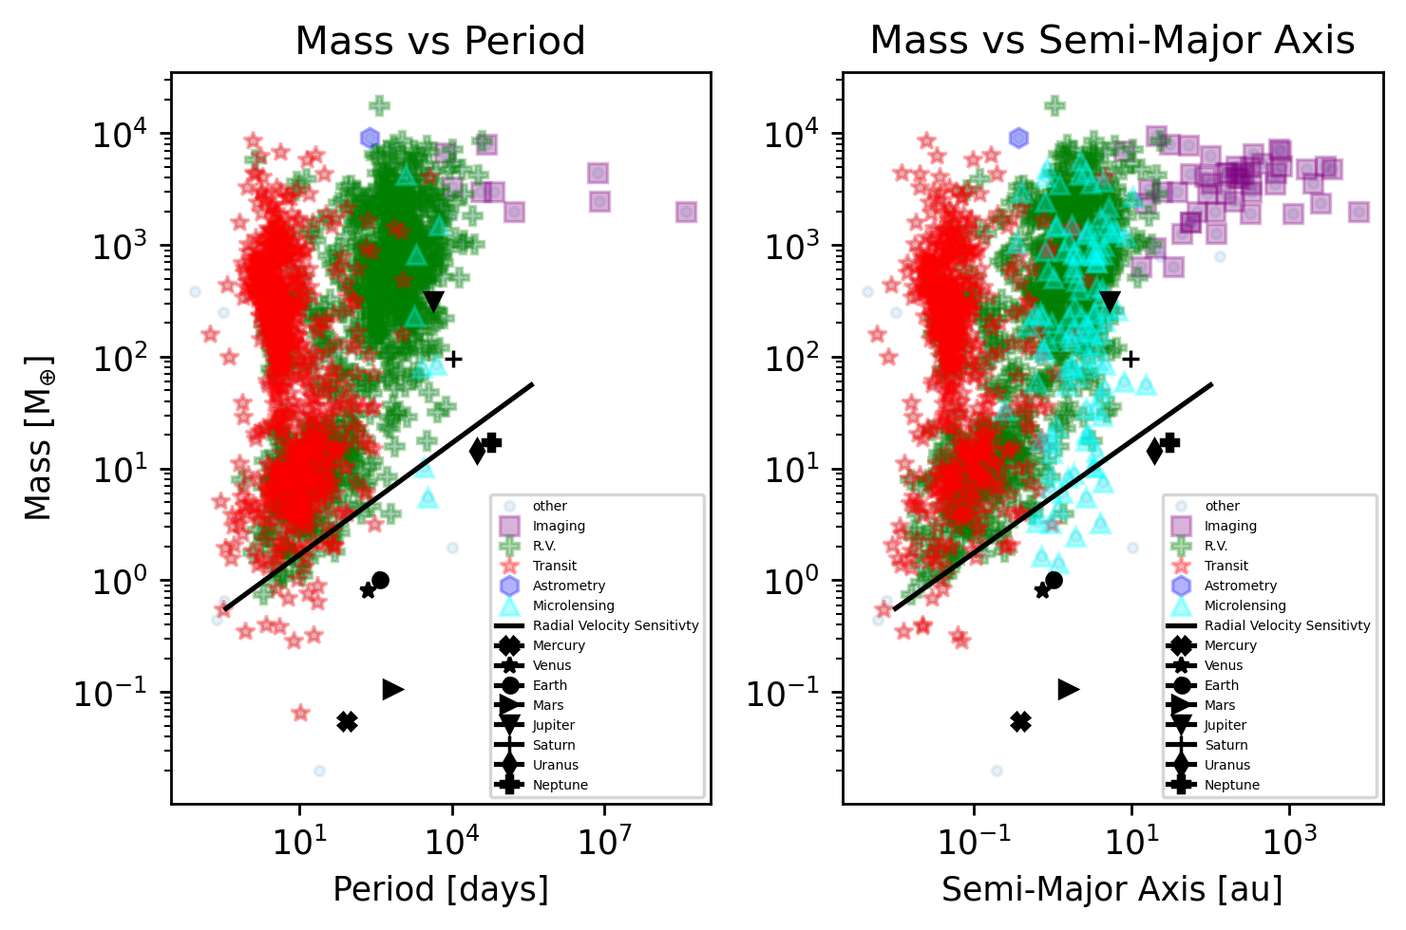
R.V. Limits
Approximately correct limit on both graphs
Solar system planets under limit
Graphs made by Tayt + Ethan

Slide 7


Transit Method Equation
SOA: SNR = 7.1
90 day observation period
CDPP is 30 ppm
Orbiting Sun-like star
Equations calculated by Tayt + Bailey

Slide 8
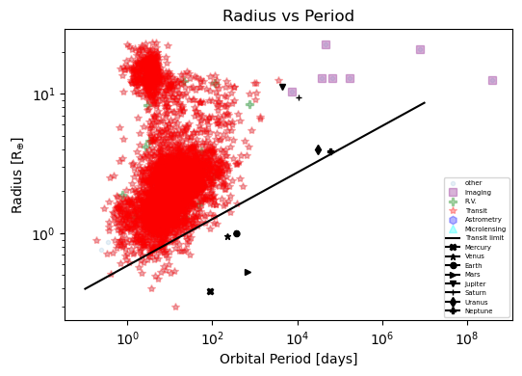
Transit Limits
Approximately correct limit
Solar system planets beneath limit again
Graphs made by Tayt + Ethan

Slide 9
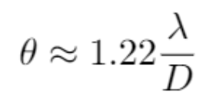
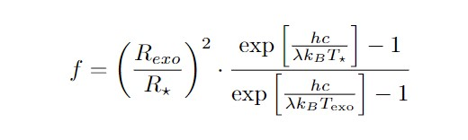
Direct Imaging Limits
Rayleigh Limit:
Closest imaged system used for distance
Observational wavelength of 22.3 micrometers
SOA: f = 1e-7
Orbiting Sun-like star
Star-Planet Contrast:

Slide 10
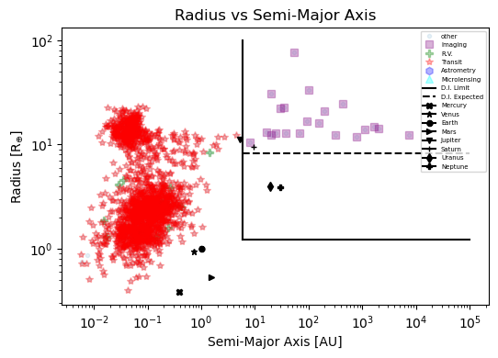
Direct Imaging Limits
Exoplanet radius limit calculated appears low
Dotted line gives expected limit
Graphs made by Tayt + Ethan

Slide 11
Simulated System (Radial Velocity Method)
State-of-the-art signal velocity: 0.5 m/s
Simulated signal velocity: 12.02 m/s
Jupiter-like planet can be detected using radial velocity!
Simulations done by Caitlin

Slide 12
Simulated System (Transit Method)
Probability of transit being aligned correctly is ~0.094%
State-of-the-art SNR: 7.1
Simulated SNR: 163
Jupiter-like planet might be detected using transit method
Simulations done by Caitlin

Slide 13
Simulated System (Direct Imaging Method)
State-of-the-art star-planet contrast: 1e-7
Simulated star-planet contrast: 8.79e-6
Could be detected! (Sort of…)
Rayleigh limit is not obeyed for Jupiter analog
Simulations done by Caitlin

Slide 14
Conclusions
Radial velocity and transit detections perform remarkably well
Direct imaging limits are incorrect
Exoplanets have the potential to exist below detection limits

Slide 16
Combined Differential Photometric Precision
Source: Howard et al., 2012
“Typical 3 hr… values are 30-300 ppm”
Equation uses 3 hr time intervals
30 ppm maximizes SNR

Slide 17
Peak Blackbody Wavelength / Jupiter Temperature
Source: (Naumov 1965)
Paper derives peak blackbody emission wavelength as 22.3 micrometers
Cites a Jupiter temperature of 130 K

Slide 18
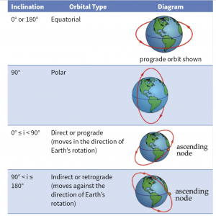
Inclination Is 90 Degrees
Wobble motion perpendicular to viewer
Most blue/redshift light observed
Strength of signal greatest

Slide 19
Rayleigh Limit (Direct Imaging)
Normal limit gives angular separation, not semimajor axis (a)
Need to know distance to system to get a
The closer the system, the more likely Rayleigh Limit is obeyed
Assume Jupiter is as close as closest imaged exoplanet

